Slide 1
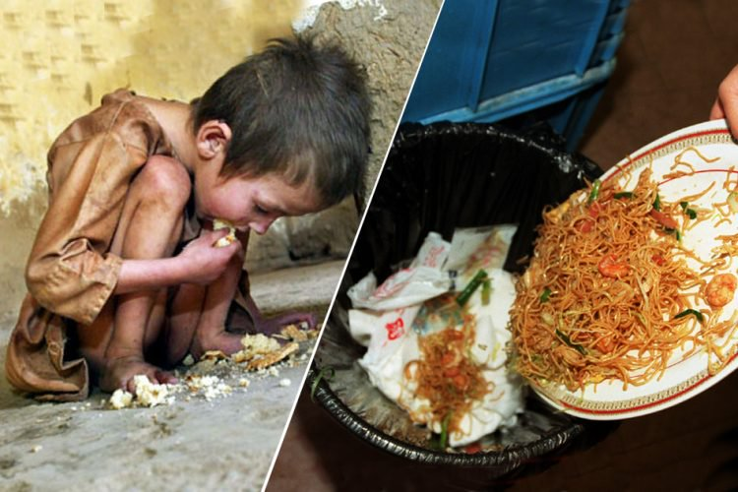
Smart Food Waste Management System
Kasun Eranda Wijethilake
10/11/2024

Slide 2
Executive Summary
Business Objective: Monitor and Manage Food Consumption and Wastage Effectively via Machine Learning Models
Problem Statement:
What are the common food waste patterns among different demographics?
How can we predict food waste based on purchasing and consumption behaviors?
What actionable recommendations can be provided to users to help them reduce their food waste effectively?

Slide 3
Analytical Approach
Methodology : Descriptive and Inferential Analysis
Machine Learning
Tools : Python, Streamlit, PyCharm and Jupyter
Process : Data Preprocessing
Exploratory Data Analysis
Predictive Modelling
Recommendation System
Deployment

Slide 4
Overview of the Dataset
The dataset provides details of food consumption and wastage of set of households, including:
Household_ID
Dietary_Preferences
Family_Size
Food_Item
Purchase_Amount
Consumption_Amount
Waste_Amount
Waste_Type
Storage_Method
Disposal_Method
Timestamp
No of records : 1,000

Slide 5
Description of the Dataset
Description | Family_Size | Purchase_Amount | Consumption_Amount | Waste_Amount
Count | 1000 | 1000 | 1000 | 1000
Mean | 3.54 | 10.26 | 5.33 | 4.93
Standard Deviation | 1.71 | 5.39 | 4.18 | 4.25
Minimum | 1 | 1.04 | 0.50 | 0.00
25% | 2 | 5.69 | 1.81 | 1.42
50% | 4 | 10.17 | 4.14 | 3.87
75% | 5 | 14.69 | 7.90 | 7.30
Maximum | 6 | 19.9 | 19.89 | 18.68

Slide 6
Data Cleaning and Preprocessing
Data Types : Data type of “Timestamp” is configured as object and it was converted to datetime64
Attribute | Data Type
Household_ID | object
Dietary_Preferences | object
Family_Size | int64
Food_Item | object
Purchase_Amount | float64
Consumption_Amount | float64
Waste_Amount | float64
Waste_Type | object
Storage_Method | Object
Disposal_Method | object
Timestamp | datetime64[ns]

Slide 7
Data Cleaning and Preprocessing cont…
Missing Types : There were no missing values
Attribute | Number of Missing Values
Household_ID | 0
Dietary_Preferences | 0
Family_Size | 0
Food_Item | 0
Purchase_Amount | 0
Consumption_Amount | 0
Waste_Amount | 0
Waste_Type | 0
Storage_Method | 0
Disposal_Method | 0
Timestamp | 0

Slide 8
Data Cleaning and Preprocessing cont…
Label Encoding is done on below fields,
Dietary_Preferences : {'Omnivore': 0, 'Pescatarian': 1, 'Vegan': 2, 'Vegetarian': 3}
Food_Item : {'Beverages': 0, 'Dairy': 1, 'Fruits': 2, 'Grains': 3, 'Meat': 4, 'Snacks': 5, 'Vegetables': 6}
Waste_Type : {'Avoidable': 0}
Storage_Method : {'Frozen': 0, 'Pantry': 1, 'Refrigerated': 2}
Disposal_Method : {'Compost': 0, 'Donation': 1, 'Feed Animals': 2, 'Trash': 3}

Slide 9
Data Cleaning and Preprocessing cont…
Normalization is done on below fields,
Purchase_Amount
Consumption_Amount
Waste_Amount

Slide 10
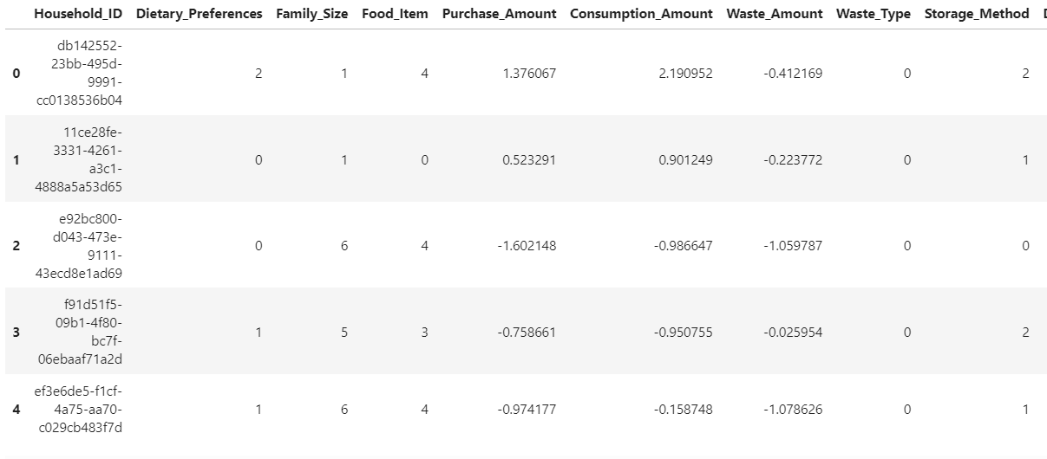
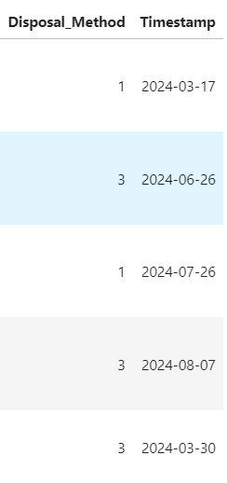
Data Cleaning and Preprocessing cont…
Final data is shown as below,

Slide 11
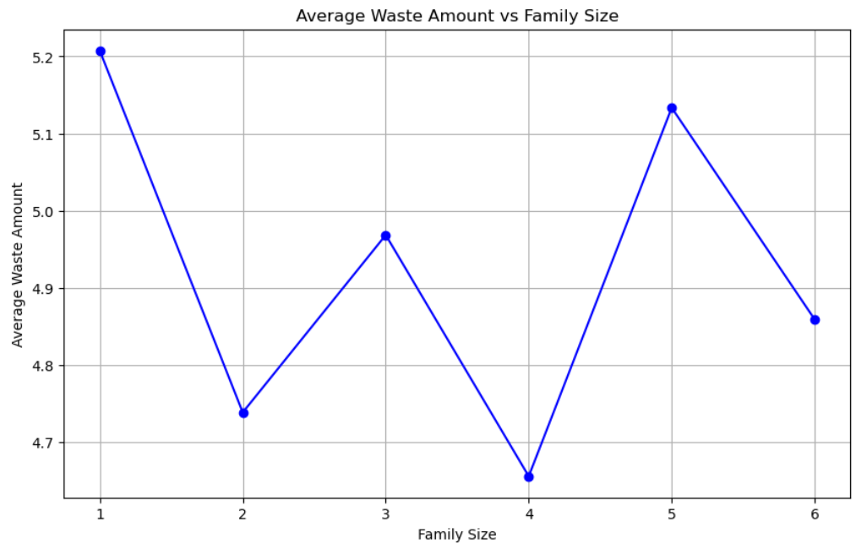
Exploratory Data Analysis
Average Waste Amount Vs Family Size

Slide 12
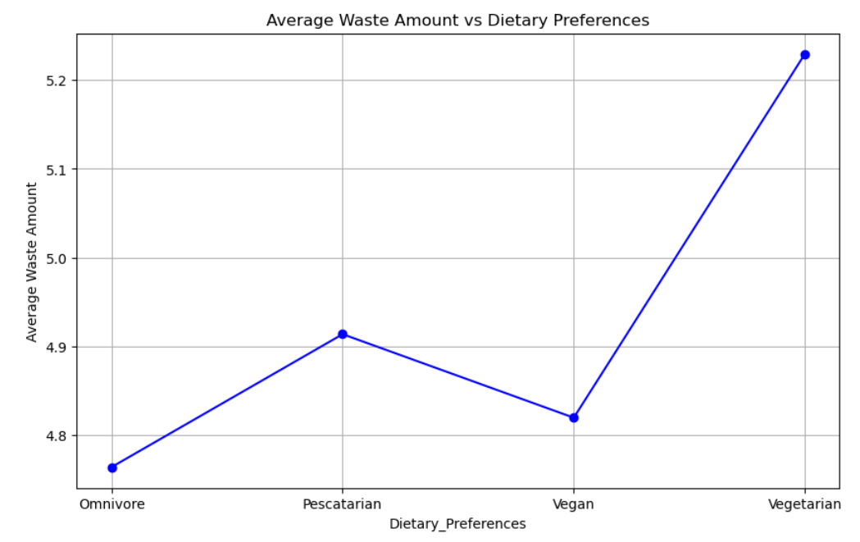
Exploratory Data Analysis
Average Waste Amount Vs Dietary Preferences

Slide 13
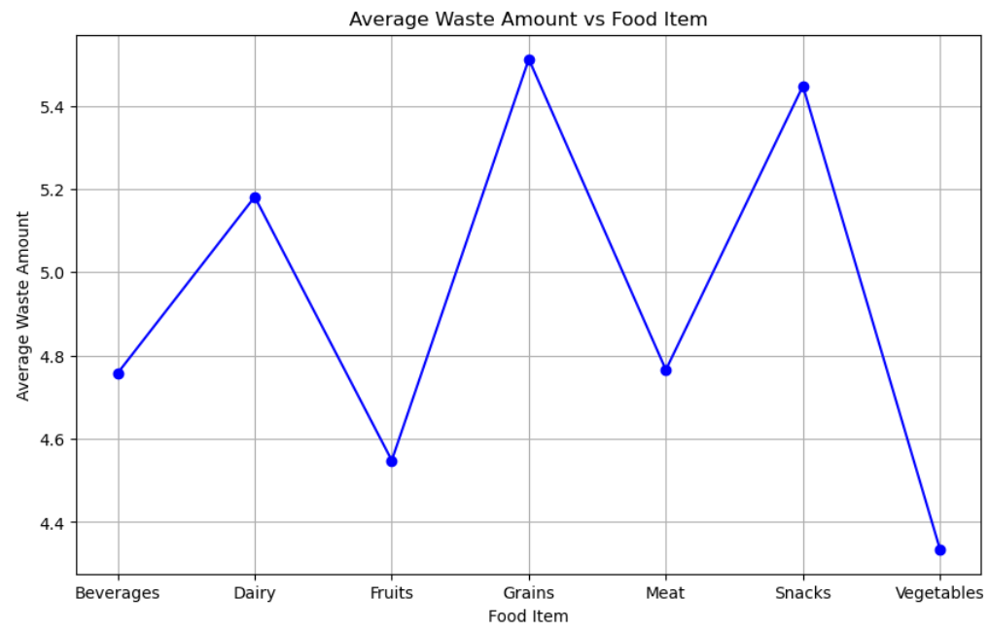
Exploratory Data Analysis
Average Waste Amount Vs Food Item

Slide 14
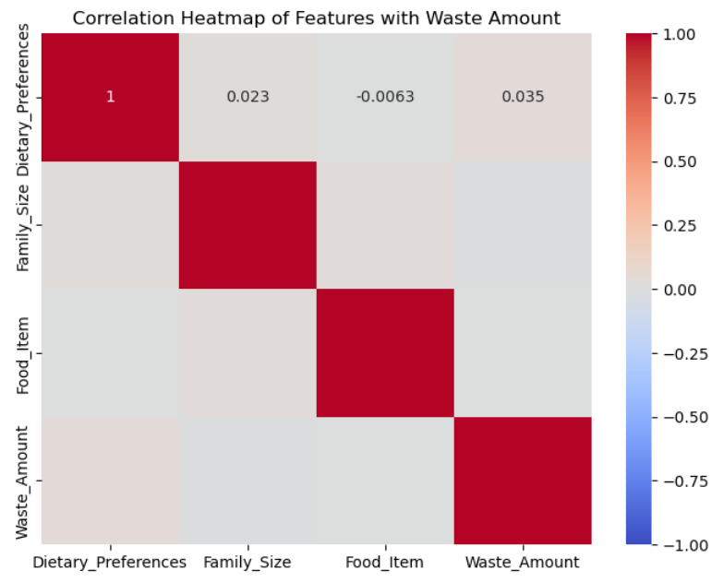
Exploratory Data Analysis cont…
Correlation of Average Waste
Amount Vs Dietary Preferences,
Family Size and Food Item

Slide 15
Predictive Modelling
Developed ML Models,
Logistic Regression
Random Forest
Gradient Boosting
Neural Network
Comparison of ML models based on metrics
Metric | Logistic Regression | Random Forest | Gradient Boosting | Neural Network
Mean Squared Error | 2.561 | 0.107 | 0.122 | 0.022
R-squared | 0.999 | 0.992 | 0.991 | 0.998

Slide 16
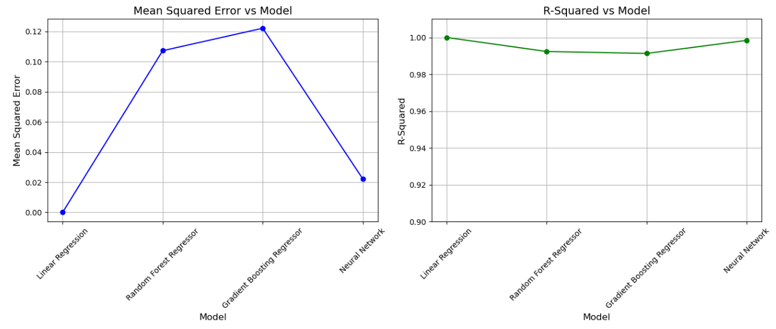
Predictive Modelling cont…
Selecting the best performing model,

Slide 17
Recommendation System
Recommendation System was developed based on below recommendations,
Dietary Preference | Recommendation
Omnivore | Incorporate leftover ingredients into new recipes to reduce waste
Pescatarian | Plan meals around fresh seafood and consume it early to avoid spoilage
Vegan | Focus on plant-based proteins and avoid buying perishable produce in bulk
Vegetarian | Use meal prep to ensure plant-based foods are consumed before expiration
Storage Method | Recommendation
Frozen | Label frozen items with dates and defrost only what you need
Pantry | Keep items like grains and canned goods organized by expiration date
Refrigerated | Store leafy greens in sealed containers and avoid overpacking the fridge

Slide 18
Recommendation System
Recommendation System was developed based on below recommendations,
Other Conditions | Recommendation
Purchase_Amount > 1.2 X Consumption_Amount | Reduce the quantity of items purchased to match consumption levels
Waste_Amount > 2 (Normalized Value) | Track weekly waste and adjust shopping lists accordingly

Slide 19
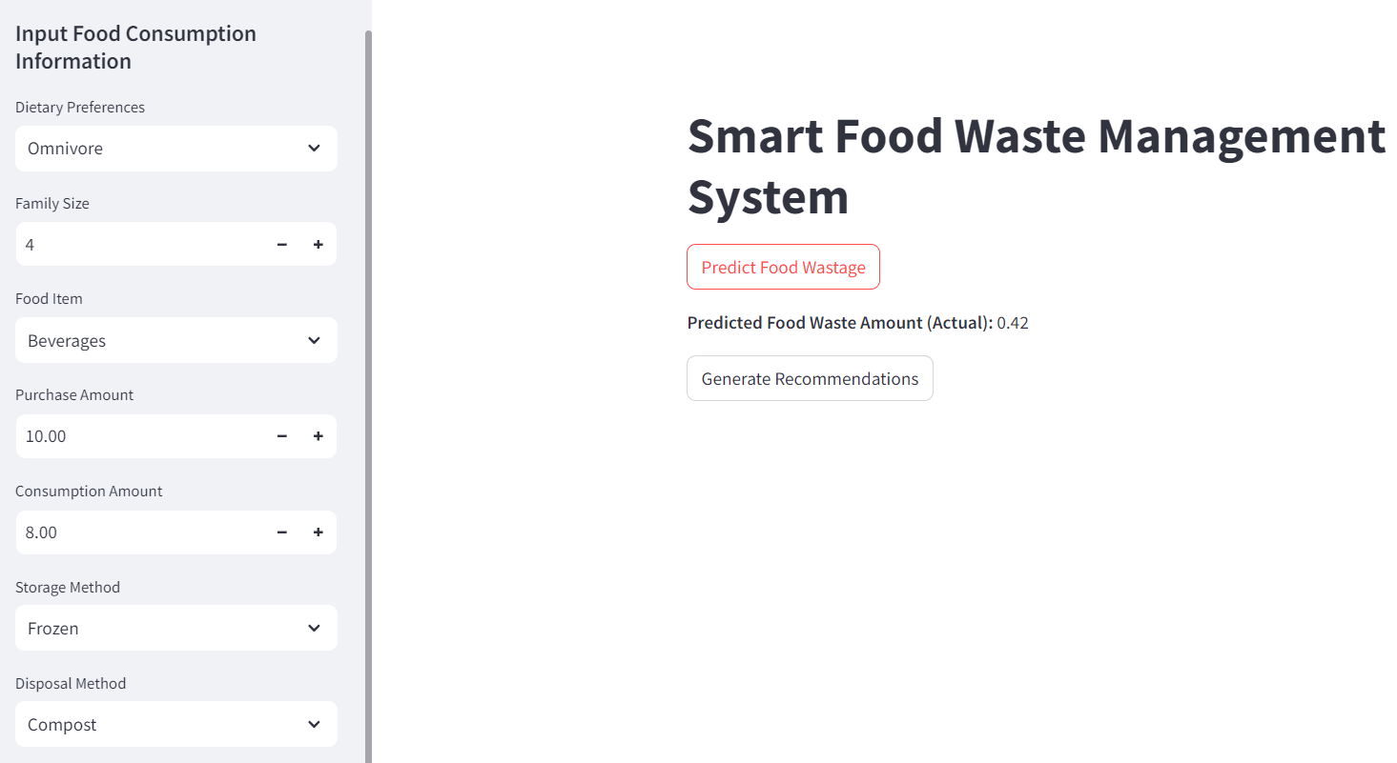
Model Deployment via Streamlit
Web App was developed using the Random Forest Model

Slide 20
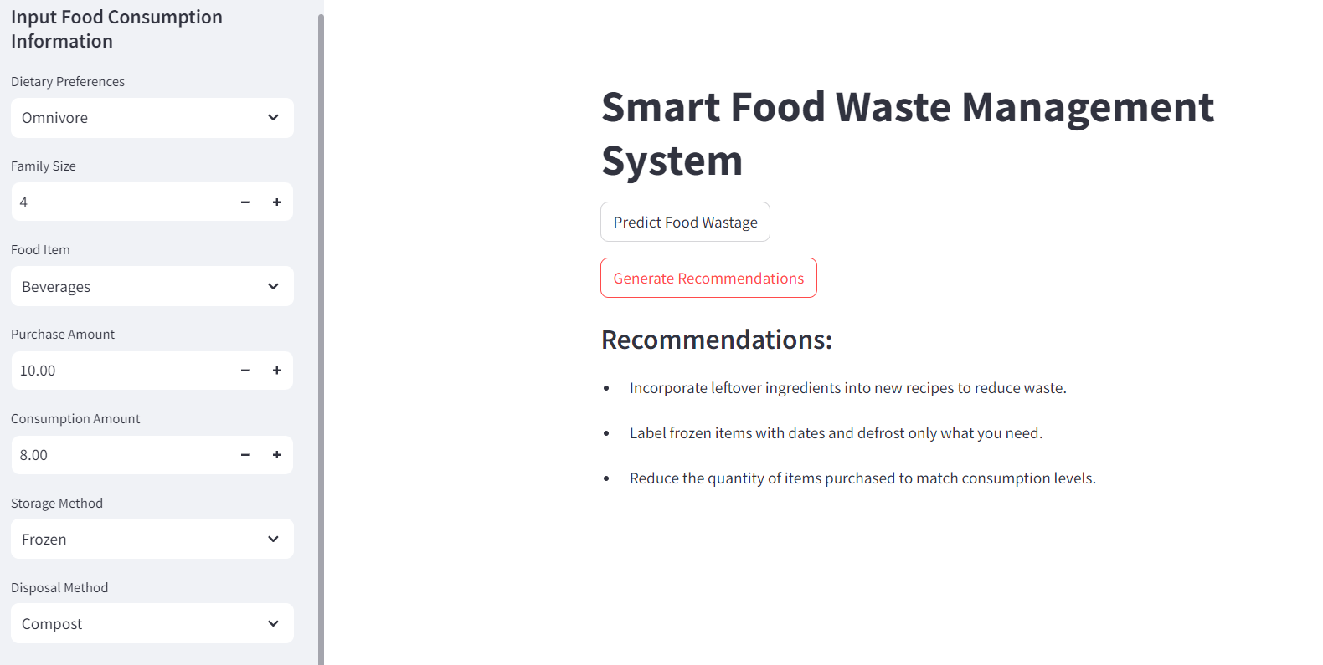
Model Deployment via Streamlit
Web App was developed using the Random Forest Model

Slide 21
Conclusions
Average Food Wastage is higher when the family size is 1 and 5 and it is low when it is 4
Highest Average Food Wastage is recorded when the dietary preference is Vegetarian and lowest when it is Omnivore
Average Food Wastage is higher for Food Items Grains and Snacks and it is lowest for Vegetables
Best performing model for the prediction out of Linear Regression, Random Forest, Gradient Boosting and Neural Network is the Linear Regression and then the Neural Network
Recommender system can be used to control the food wastage properly

Slide 22
Q & A

